Slide 1
2_6_2025

Slide 2
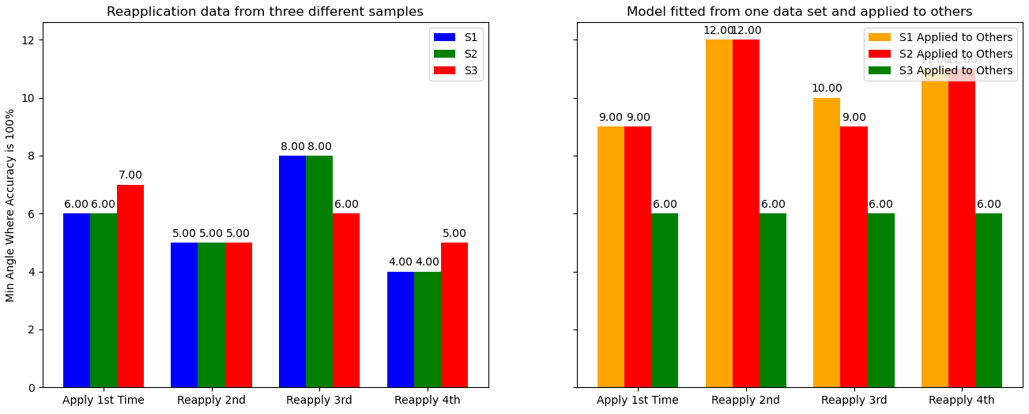
3 Samples of Reapplication Data

Slide 3
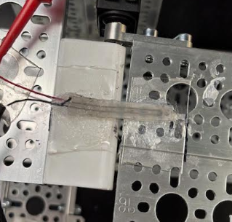
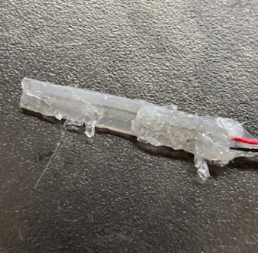
Sample After Peeling Off

Slide 4
Optical Microscope Investigations

Slide 5
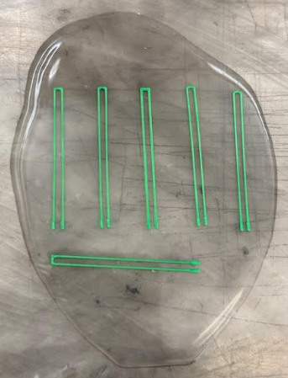
Measured ABS Dimensions: See Spreadsheet

Slide 6
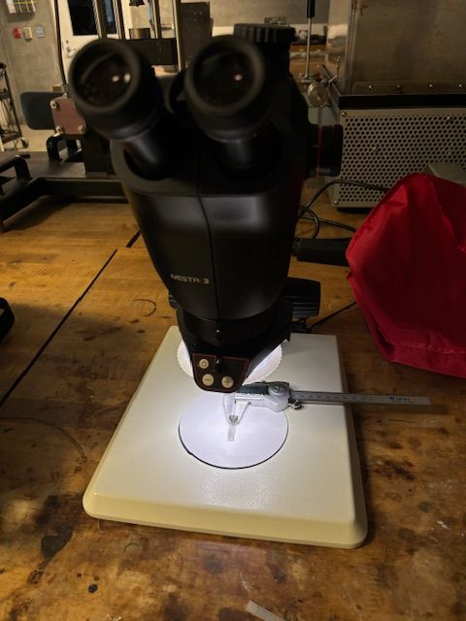
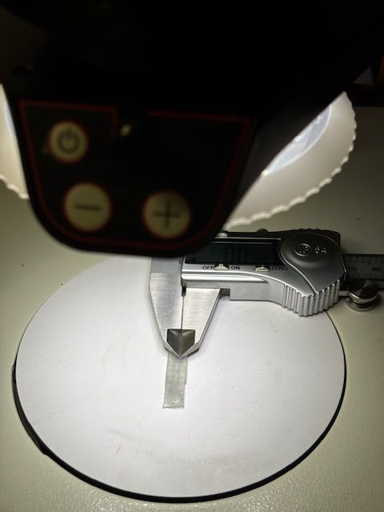
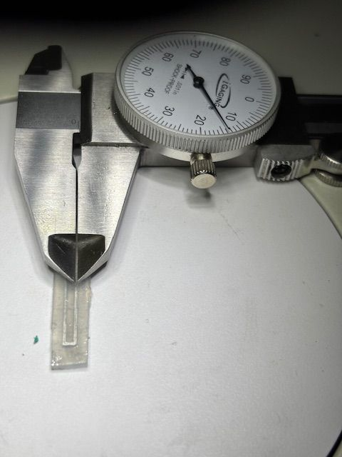
Optical Microscope Investigation
Leica Ivesta 3 Optical Microscope at CSUM
Channel Width (NOT HEIGHT YET) -> 2 samples
0.0145 | 0.0145 | 0.013
0.0135 | 0.0135 | 0.0135
 | ave | std
 | Ave 0.01375 | Std 0.000559

Slide 7
Papers Discussing Channel “Collapse” or Bending
Reduction in channel dimensions references:
Yeguang Xue, Daeshik Kang, Yinji Ma, Xue Feng, John A. Rogers, Yonggang Huang, Collapse of microfluidic channels/reservoirs in thin, soft epidermal devices, Extreme Mechanics Letters, Volume 11, 2017, Pages 18-23, ISSN 2352-4316, https://doi.org/10.1016/j.eml.2016.11.012.
Fanbo Meng, Jiexi Huang, M. D. Thouless. The Collapse and Expansion of Liquid-Filled Elastic Channels and Cracks, Journal of Applied Mechanics, J. Appl. Mech. Oct 2015, 82(10): 101009, https://doi.org/10.1115/1.4031048

Slide 8
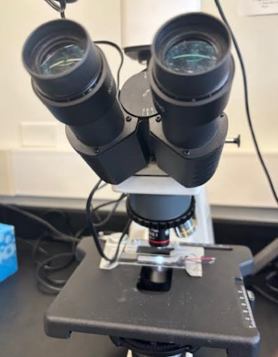
Using a “Real” Optical Microscope to Confirm

Slide 9
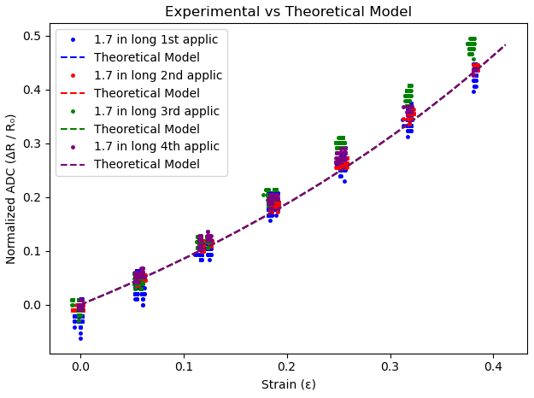
1 Sample from 2_4_2025: Model Applied to Reapplication Data
Ideal Cross-Sectional Area Measured ABS:
area = 0.021 in * 0.0267 in
Cross-Sectional Area Used For Model:
area = 0.021 in * 0.01375 in

